Slide 1

Higher-Order Functions
Higher-Order Function, Reactive FP, Applicative Functors
SoftUni Team
Technical Trainers
Software University
https://softuni.bg

Slide 2
Table of Contents
Higher-Order Functions
Arrays Methods
Function Composition
Promises
Functors
Monads
Applicative Functors
Conclusion

Slide 3

Higher-Order Functions
Take and/or Return Function as Argument

Slide 4
Overview
Higher-order function == function operating on other functions
One function is higher-order when:
Passes a function as an argument to another function
Returns a function from another function
Higher-order functions are exactly a higher level of abstraction than your typical functions
h ( x ) = f ( g ( x ) )
function parent(child) { child(); }
function animal() { return () => { return 'cat'; } }
let add = (a) => (b) => a + b;

Slide 5
Higher Order Function
Argument Type
Some Input
Function
Higher-Order Function
OR
Higher-Order Function
Return Type
Function
Some Output

Slide 6
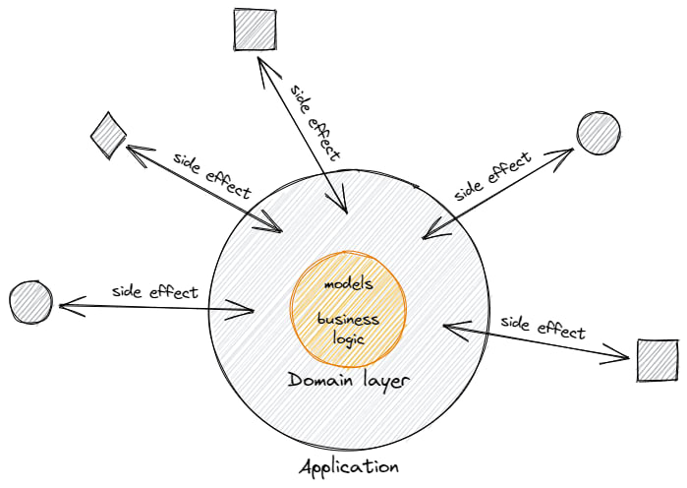
Overview (2)
Higher-order function is a fundamental concept built in the JavaScript language
Higher-order function in conjunction with the pure function will help you keep your code clean and side effects free

Slide 7
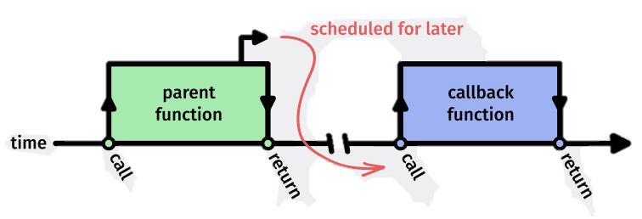
Higher-Order Function vs Callback Function
Higher-order functions and callback functions are different
Higher-order functions – a function that takes another function as an argument and/or returns a function as a value
Callback functions – a function that is passed to another function

Slide 8
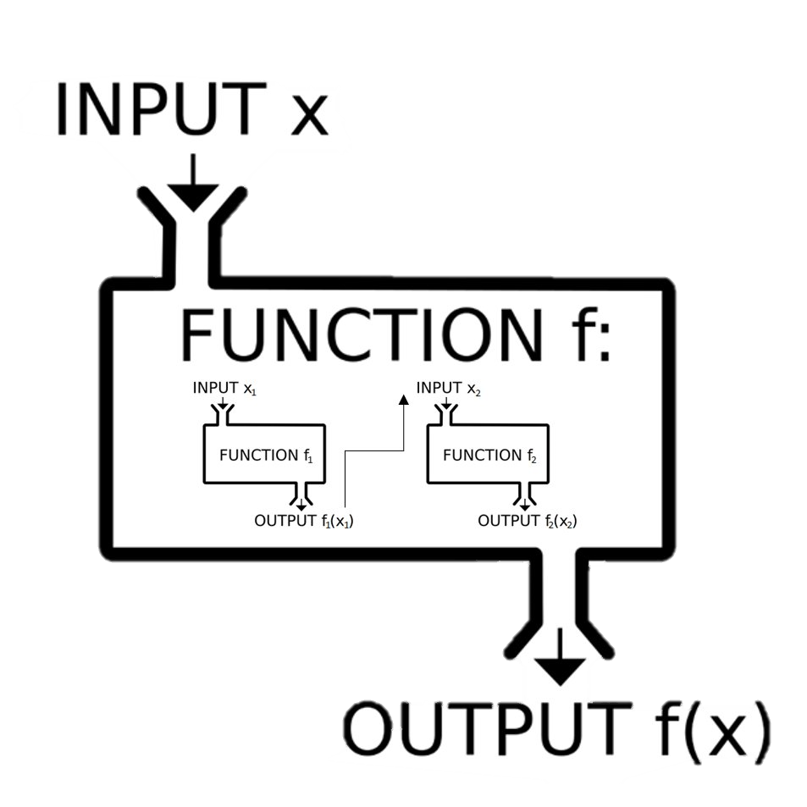
Behavior
Higher-order functions allow us to abstract over actions, not just values
function greaterThan(n) {
return m => m > n;
}
let greaterThan10 = greaterThan(10);
console.log(greaterThan10(11));
// true

Slide 9

Higher-Order Function and Closure
Higher-order functions are actually incredibly common in JS
Any time you pass a callback function, this is a higher-order function in action
Using a closure is also a higher-order function pattern
Closure always returns another function that can be executed later
setTimeout(() => {
console.log("This message is shown after 3 seconds");
}, 3000);

Slide 10
Properties of the Higher-Order Function
The function will work as an instance of the object type
We can easily store the function in the form of the variable
Function can contain another function as a parameter
let cat = () => { return 'cat' };
function greeting(value){
return ("Hello " + value);
}
function result(x, func) { console.log(func(x)); }
result("David", greeting); // Hello David

Slide 11

Performance Issue
Higher-order functions are great for writing clear code
Unfortunately, this clarity comes at a cost
Passing a function to higher order functions and letting that method handle the array iteration is easy to read
But function calls in JS are costly compared to simple loop bodies
Fortunately, most browsers are insanely fast
Higher-order performance is can be slow compared to simple loops

Slide 12

Arrays Methods
Map, Filter, Reduce

Slide 13
First-Class Objects
JavaScript functions are first-class objects
They have built-in properties and methods, such as the name property and the .toString() method
Properties and methods can be added to them
const originalFunc = (num) => { return num + 2 };
const newFunc = originalFunc;
newFunc.name; // originalFunc
newFunc.toString(); // '(num) => { return num + 2 }'
newFunc.isMathFunction = true;

Slide 14
Arrays Methods – .forEach() and .filter()
The .forEach() method executes a callback function on each of the elements in an array in order
The .filter() method executes a callback function on each element in an array, and for each element returns true or false
const numbers = [28, 77, 45, 99, 27];
numbers.forEach(number => { console.log(number); });
const randomNumbers = [4, 11, 42, 14, 39];
const filteredArray = randomNumbers.filter(n => {
return n > 5; });
// [11, 42, 14, 39]
New array with any elements for which the callback function returns true

Slide 15
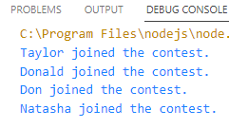
The .map() Method
The .map() method executes a callback function on each element in an array
It returns a new array made up of the return values from the callback function
The original array does not get altered
The returned array may contain different elements than the original
const participants = ['Taylor', 'Donald', 'Don', 'Natasha'];
const announcements = participants.map(member => {
return member + ' joined the contest.’; });
announcements.join('\n');

Slide 16
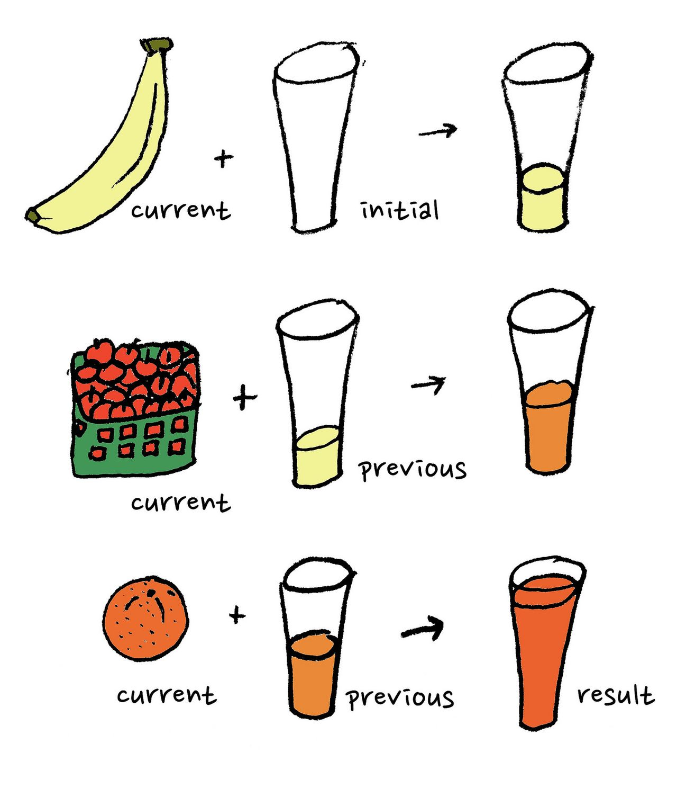
The .reduce() Method
The .reduce() method iterates through an array and returns a single value
It takes a callback function with two parameters (accumulator, currentValue)
const arrayOfNumbers = [1, 2, 3, 4];
const sum = arrayOfNumbers.reduce( (accumulator, currentValue) => {
return accumulator + currentValue;
});
console.log(sum); // 10

Slide 17
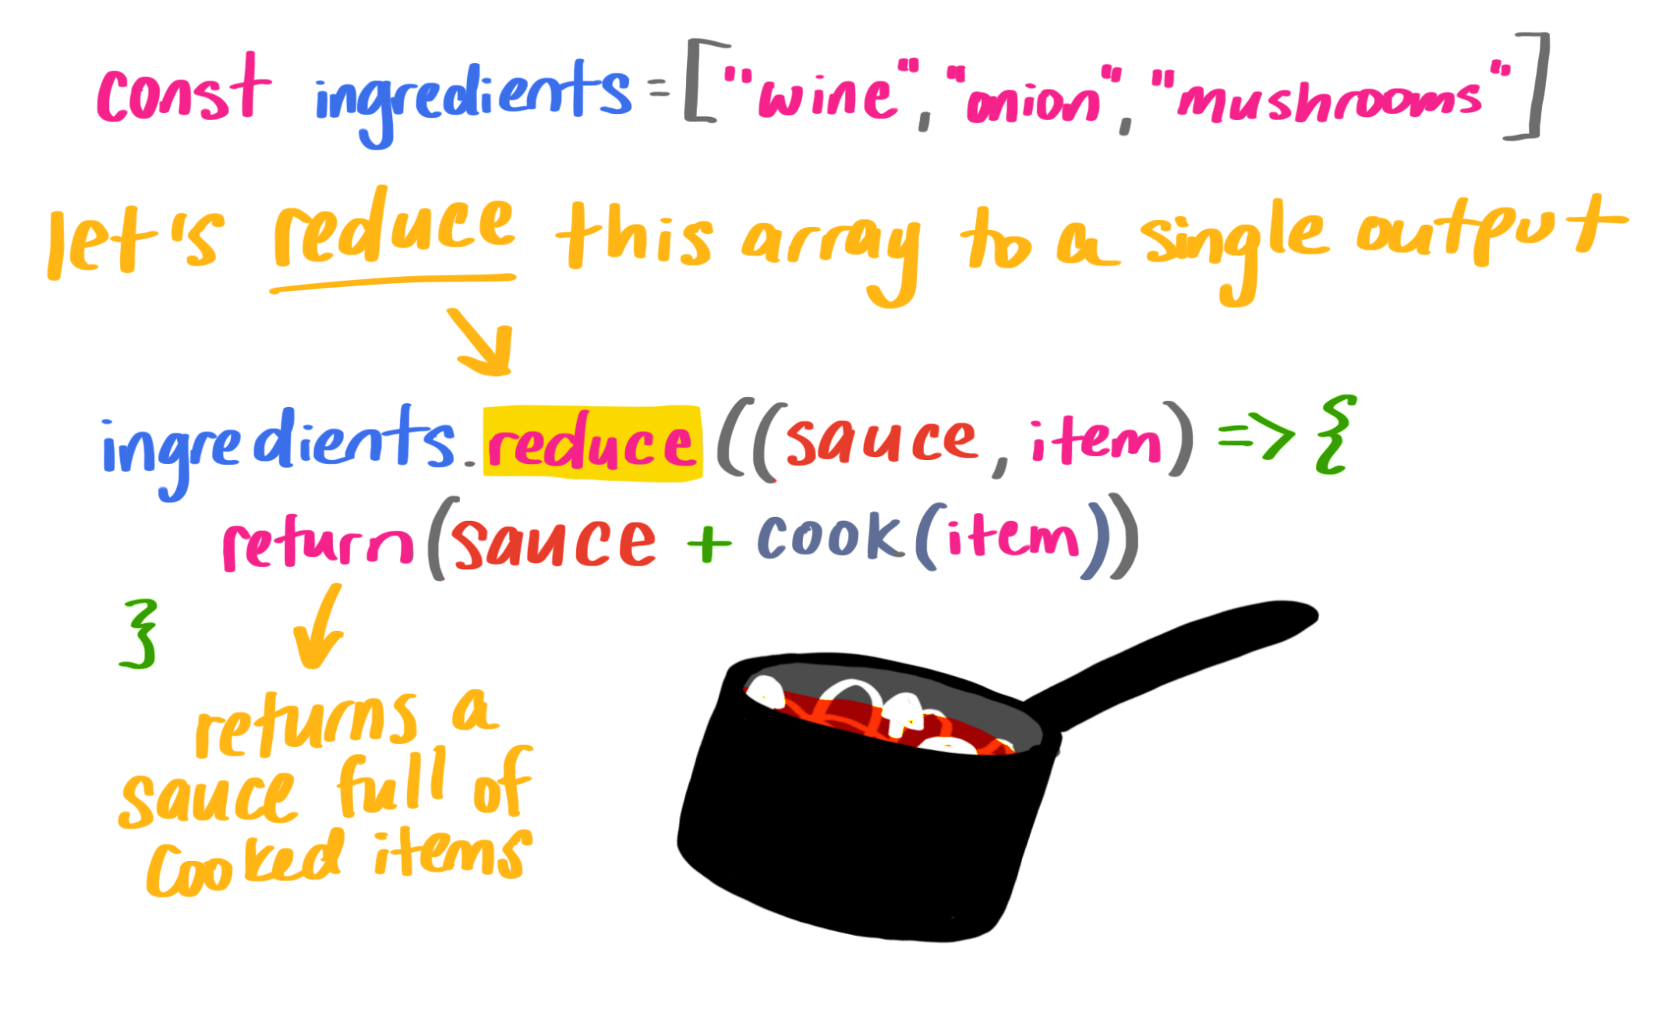
The .reduce() Method – Example

Slide 18
Arrays Methods
.map( => )
.filter( )
.find( )
.fill( 1, )
.reduce( )

Slide 19
Summary
Array
Array
Array
Array
forEach()
map()
reduce()
filter()
No return
New array with modified items
Single value
New array with values according to the filter
Usually is used to mutate existing array or for side-effect

Slide 20
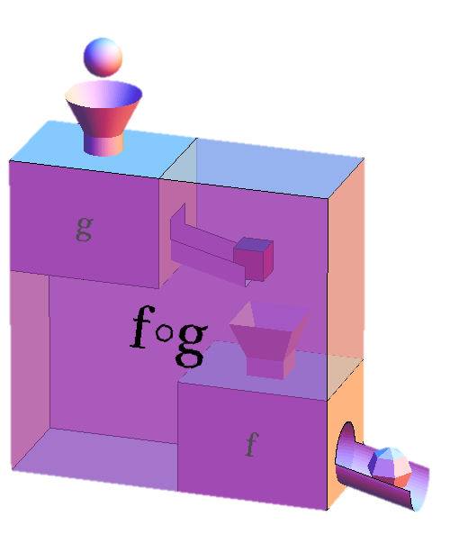
Function Composition
Pointwise Application

Slide 21
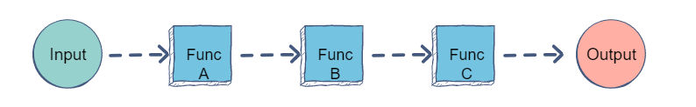
Function Composition
Function composition is the process of combining two or more functions to produce a new function
Function compositions can be composed of any number of functions
const increaseByFive = (x) => x + 5;
const divideByTwo = (x) => x / 2;
const result = (x) => increaseByFive(divideByTwo(x));
result(5); // 5

Slide 22
Compose
Compose will take the output from one function and automatically patch it to the input of the next function
Compose will repeat that process again and again until it spits out the final value
const result = (x) => increaseByFive(divideByTwo(x));
g( )
f(x)

Slide 23
Compose – Examples
Use a library (Ramda or Lodash) or make our own compose method:
Functional composition using our own compose method:
const compose = (…func) => x => func.reduceRight((y, f) => f(y), x);
This higher-order function accepts any number of functions as a parameter then returns a function that will invoke those given functions from right to left
const addFive = (x) => x + 5;
const divideByTwo = (x) => x / 2;
const result = (x) =>
addFive(devideByTwo(x));
result(5); // 5
const addFive = (x) => x + 5;
const divideByTwo = (x) => x / 2;
const result = compose(addFive, devideByTwo);
result(5); // 5

Slide 24
Real-Life Examples
Real-life examples are adding authentications, logging and context properties
It’s a technique that enables reusability on the highest level
const addTwo = n => n + 2;
const double = n => n * 2;
const doubleAddTwo = n => addTwo(double(n));
const addSix = n => addTwo(addTwo(addTwo(n)));
console.log(doubleAddTwo(5)); // 12
console.log(addSix(2)); // 8

Slide 25
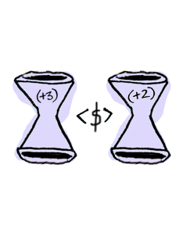
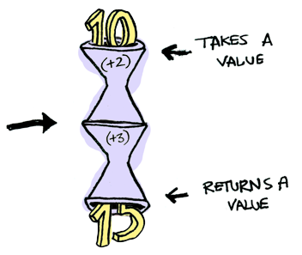
Function Composition – Example
What happens when you apply a function to another function?
let plusTwo = (x) => { x + 2 };
let plusThree = (x) => { x + 3 };
let compose = function(f, g) {
// return a composed function
return function(x) {
return f(g(x));
};
};
compose(plusThree, plusTwo)(10);
// "15"

Slide 26

Conclusion
Function composition enables reusability of a functionality at a very high level
If the functions are structured well they enable the developers to create new behavior based upon existing behavior
It also increases readability of implementations
Instead of nesting functions you can clearly chain functions and create higher-order functions with meaningful names

Slide 27

Functions Overview
All functions are the same in syntax, named according to their semantic usage
HOF is a function that accepts functions and returns functions
Predicate is a function that takes a parameter and returns a Boolean
Callback is a function that is passed to another function to be called with the result

Slide 28
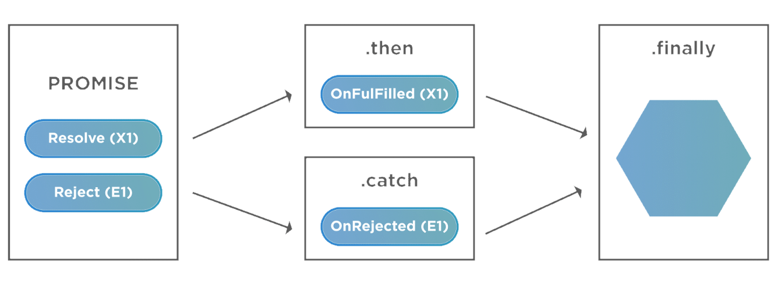
Promises
Review

Slide 29
Promises
In JS, a promise is a good way to handle asynchronous operations
It is used to find out if the asynchronous operation is successfully completed or not
A promise may have one of three states
Pending
Fulfilled
Rejected
new Promise ()
resolve ()
reject ()
Go to next action
Handle Error

Slide 30
Promises - Diagram
Promise starts in a pending state. That means the process is not complete
If the operation is successful, the process ends in a fulfilled state
RESOLVED
PENDING
.then()
PENDING
Promise
Promise
.catch()
REJECTED
Add finally()
And, if an error occurs, the process ends in a rejected state

Slide 31
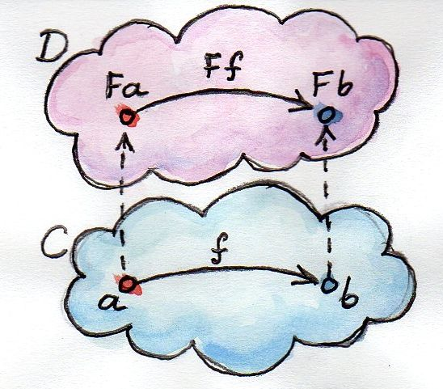
Functors
Mapping Between Categories

Slide 32
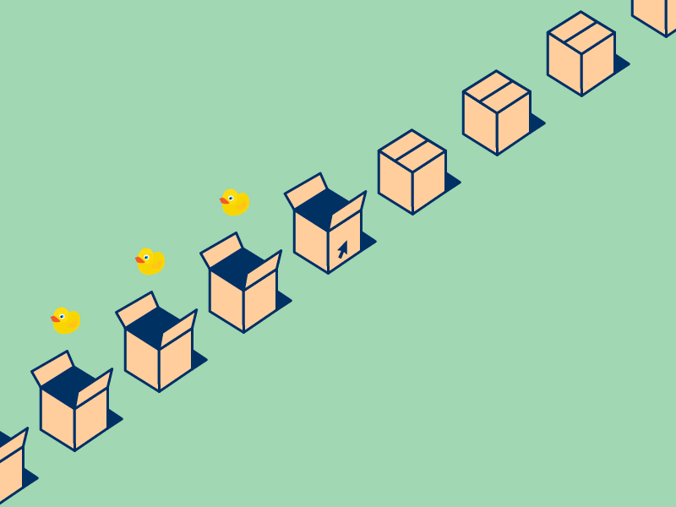
Functor
Functors are objects that implement map
Arrays
Single values
Object literal
Pure functions
Functors are commonly used in computer science to mean higher-order functions

Slide 33
Functor (2)
Functor is something that is mappable or something that can be mapped
Array is mappable, so it is a functor
One of the properties of a functor is that they always stay that same type of functor
You cannot map an array of number to just a number
const array = [1, 2, 3];
const numberToString = num => num.toString();
array.map(numberToString); // ["1", "2", "3"]

Slide 34
Functor (3)
Promises use the method .then() instead of .map()
Think of .then() as an asynchronous .map() method
Using a functor is easy — just call map()
Functors laws – identity and composition
A functor is a mapping between categories
Functors must respect identity and composition
myPromise.then(data => data.json());
const numbers = [1, 2, 3];
numbers.map(x => x * 2); // [2, 4, 6]

Slide 35
Identity & Composition
If you pass the identity function (x => x) into f.map(), where f is any functor, the result should be equivalent to f
Functors must obey the composition law:
const numbers = [1, 2, 3];
numbers.map(x => x); // [1, 2, 3]
F.map(x => f(g(x)))
F.map(g).map(f)

Slide 36
Category Theory
A lot of functional programming terms come from category theory, and the essence of category theory is composition
A category is a collection of objects and arrows between objects (where “object” can mean literally anything)
Arrows are known as morphisms
Morphisms can be thought of and represented in code as functions
For any group of connected objects, a -> b -> c, there must be a composition which goes directly from a -> c
All arrows can be represented as compositions
All objects in a category have identity arrows
h(x) = g(f(x))

Slide 37

Composition
Composition is associative
When you’re composing multiple functions, you don’t need parenthesis
Compose
h∘(g∘f) = (h∘g)∘f = h∘g∘f
const functor = [1, 2, 3];
functor.map(x => f(g(x))); functor.map(g).map(f);
The following have the same result
The following have the same result

Slide 38
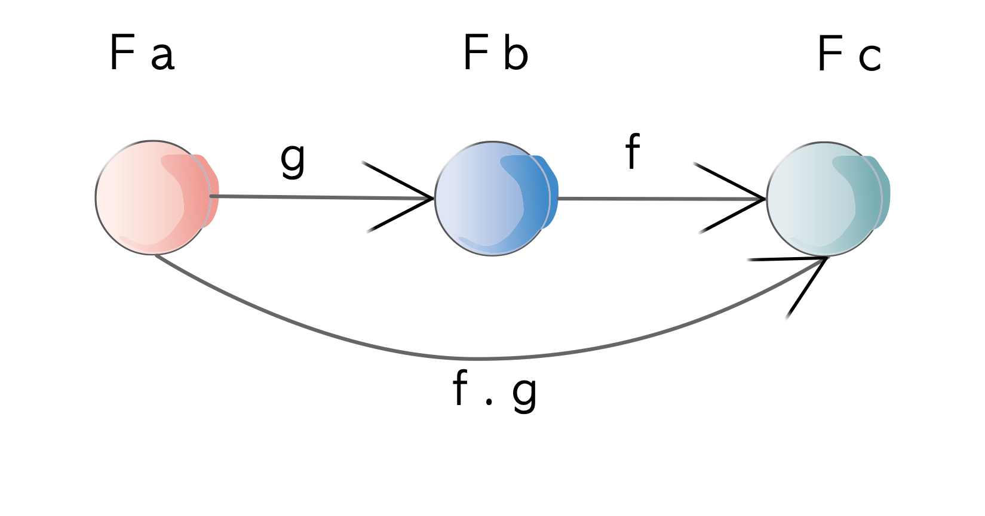
Why functors?
Functors are useful because they let us use map with collections, replacing for loops
A collection can contain multiple values and can be mapped over
Functors are important because they are a building block for applicatives and monads

Slide 39
Things functors do:
Transformation of contents
Maintain structure
Functors need to be able to contain any object and maintain its structure
Return new functor: because of this we can chain map calls
Functors are important because they are a building block for applicatives and monads
[1, 2, 3, 4].map(x => x + 2);
// [ 3, 4, 5, 6 ]
The content is transformed
[1, 2, 3, 4]
.map(x => x + 2)
.map(x => x * 3)
.map(x => x / 3);
// [ 3, 4, 5, 6 ]

Slide 40
Endofunctors
Endofunctor is a functor that maps from a category back to the same category
A functor can map from category to category:
An endofunctor maps from a category to the same category:
A monad is an endofunctor
A monad is just a monoid in the category of endofunctors
X -> Y
X -> X

Slide 41
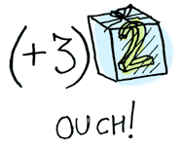
Functor - Example
When a value is wrap into array, you can’t apply a normal function to it
This is where map() comes in
map() knows how to apply functions to values that are wrapped in an array
let plusThree = function(val) {
return val + 3;
};
[2].map(plusThree); // [5]

Slide 42

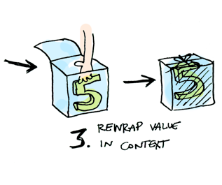
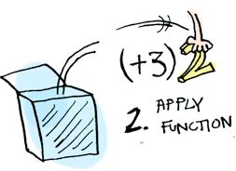

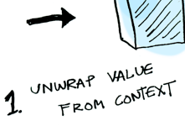
Functors – Example (2)
Here is what is happening behind the scenes when we write
[2].map(x => x + 3);
// 5

Slide 43
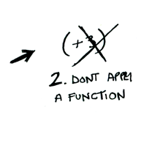
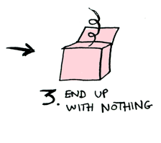
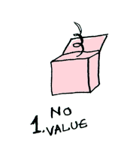
Functors – Example (2)
Add 3 to an empty array
[].map(x => x + 3);
// []

Slide 44
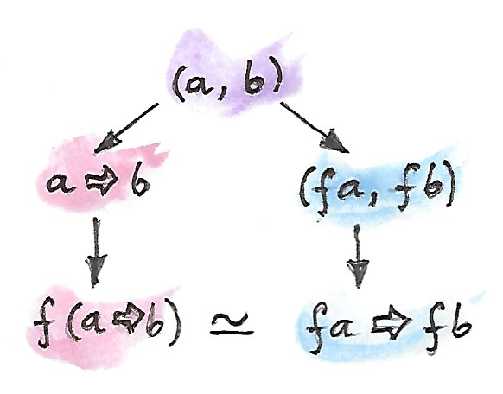
Applicative Functors
Functors With Extra Features

Slide 45
Applicative Functors
Applicatives are just functors with extra features
They give you the ability to merge two functors together
Specifically, they allow you to apply a function inside a functor to a value that's also inside a functor
In the context of JS applicatives are not a common thing to do
Doesn't mean applicatives are useless to us
const sum = (number) => number + 1;
Promise.resolve(sum);

Slide 46
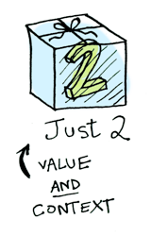

Applicatives, Functors and Monads
Applicative functor, or an applicative for short, is an intermediate structure between functors and monads
Applicatives take it to the next level
With an applicative, our values are wrapped in a container, just like functors
But our functions are wrapped in a container too!

Slide 47
Applicatives – Usage
Normally if you have a function and a value you would be able to apply the function using this syntax: some_function(some_value)
That doesn't work if both are inside another structure
To "fix" this, applicatives have a method called ap() (short for apply)
It takes care of unwrapping each functor and applying the function to the value
Wrapped values
let wrappedTwo = [2];
let wrappedThree = [3];
add(wrappedTwo, wrappedThree);
Won't work! The values are wrapped

Slide 48
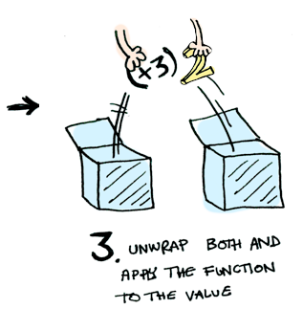
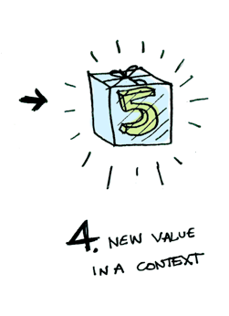
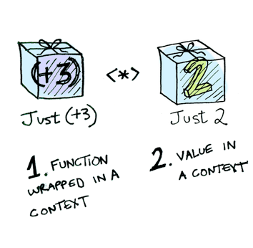
Applicatives – Example
Array.prototype.ap = function(wrappedVal) {
if (this[0] !== undefined) {
return wrappedVal.map(this[0]); // Assume this[0] is a function
} else {
return [];
}
}
wrappedPlusThree
.ap(wrappedTwo);
// [5]

Slide 49
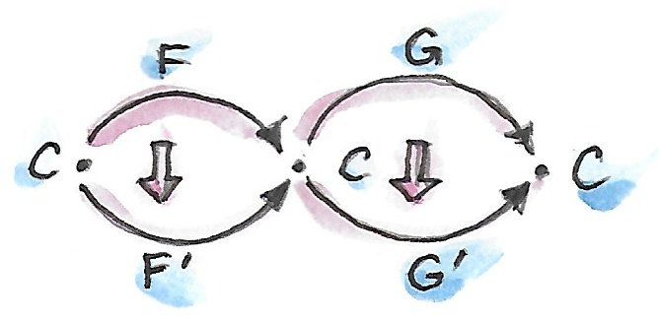
Monads
Way of Composing Functions

Slide 50
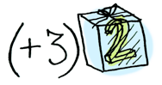
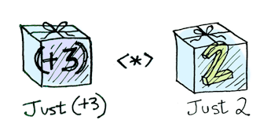
Monads
Functors apply a function to a wrapped value
Applicatives apply a wrapped function to a wrapped value
Monads apply a function that returns a wrapped value to a wrapped value
Monads have a function flatMap() to do that
Array.prototype.flatMap = function(lambda) {
return [].concat.apply([], this.map(lambda));
};

Slide 51
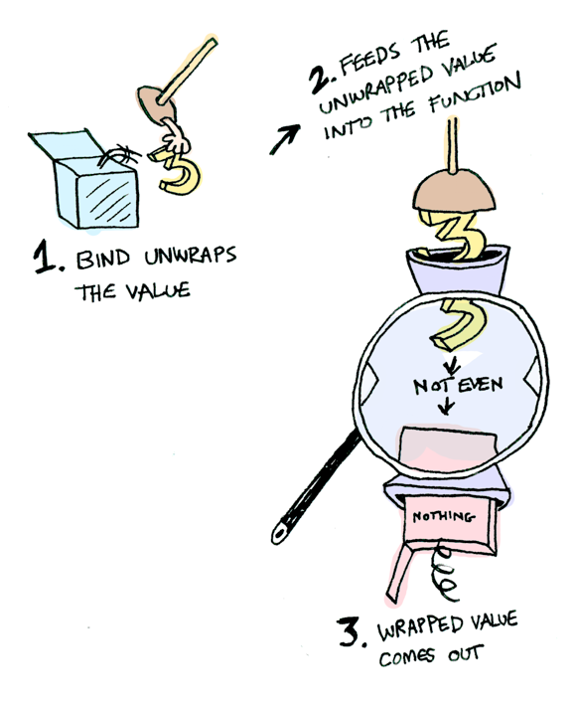
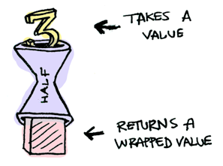

Monads – Example
What if we feed it a wrapped value?
let half = function(val) {
return val % 2 == 0 ? [val / 2] : [];
}
[3].flatMap(half);
// []
[4].flatMap(half);
// [2]
[].flatMap(half);
// []
We need to use flatMap() to shove our wrapped value into the function

Slide 52
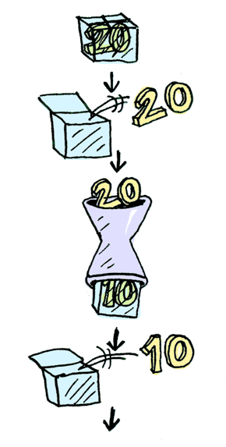
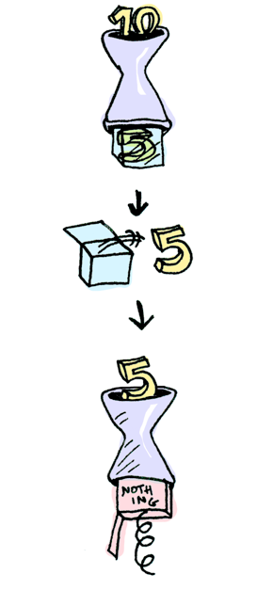
Monads – Example (2)
You can also chain these calls
let half = function(val) {
return val % 2 == 0
? [val / 2]
: [];
}
[20].flatMap(half)
.flatMap(half)
.flatMap(half);
// []

Slide 53
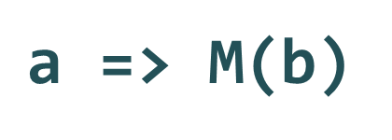
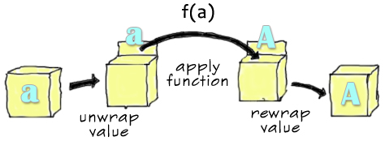
Monad Composing Function
Monad is a way of composing functions that require context in addition to the return value
Monad is a mapping from some type a to some type b along with some computational context, hidden in their implementation details

Slide 54

Monads – Advantages
Using monads makes your code easier to work with
Failing to take advantage of monads may make your code harder
The essence of software development is composition, and monads make composition easier

Slide 55

Conclusion
Functors, Monads, Applicatives

Slide 56
Functors, Applicatives, Monads
A functor is a type that implements map()
An applicative is a type that implements ap()
A monad is a type that implements flatMap()
Array implements map(), so it’s a functor
Promise implements map() and flatMap() through then, so it is a functor and a monad

Slide 57
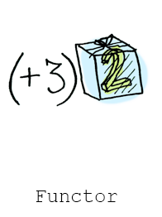
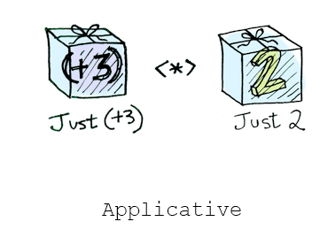
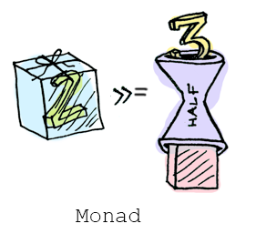
Functors, Applicatives, Monads (2)
Functors – you apply a function to a wrapped value
Applicatives – you apply a wrapped function to a wrapped value
Monads – you apply a function that returns a wrapped value, to a wrapped value

Slide 58
Summary
…
…
…
Higher-order functions – function that operates on other functions
Arrays methods – map(), filter(), reduce()
Function composition – process of combining two or more functions to produce a new function
Promises – good way to handle asynchronous operations
Functors – mapping between categories
Monads – way of composing functions
Applicative functors – functors with extra features

Slide 59
Questions?

Slide 60

License
This course (slides, examples, code, demos, exercises, tutorials, homework, projects, documents, videos and other assets) is copyrighted content, created by SoftUni
Unauthorized copy, reproduction or use is illegal
© SoftUni – https://softuni.org
© Software University – https://softuni.bg

